Slide 1
UI/UX Design
Lesson 1: UI/UX Design I
Presented by Krystal Educational Platform

Slide 2
Learning Outline
Learn about what is UI/UX design
Understand the difference between UI/UX design
Learn about the UI/UX design example
Group discussion to analyze which apps have good UI/UX design

Slide 3
Lesson Outline
Understand UI/UX Design Process
Learn about UI/UX Design knowledge
Learn about How to make a product with good UI/UX design
Use the Free UI/UX Design Resources in your UI/UX Design

Slide 4
Contents
1.1
Definition of UI/UX Design
1.2
Difference of
UI/UX Design
1.3
UI/UX Design Example
1.4
UI/UX Design Group Discussion

Slide 5
Definition of UI/UX
1.1

Slide 6
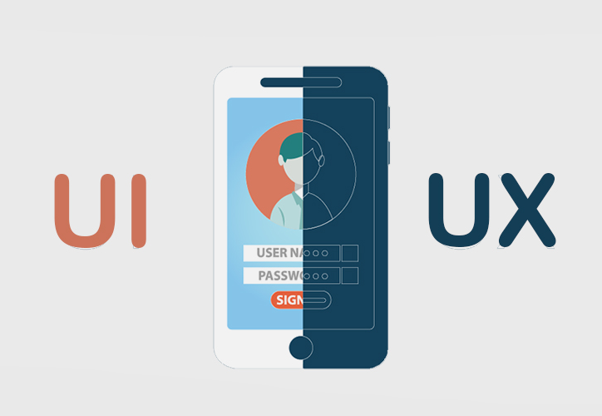
1.1 Definition of UI/UX Design
What is UI Design?
UI: User Interface
Interaction between the user and a digital device or product
The way a person controls a software application
Picture © Volunteer: UI/ UX Designer (Online Platform/ Mobile App) at SENtoR | Time Auction

Slide 7
1.1 Definition of UI/UX Design
What is UX Design?
UX = User Experience
Interactions between a potential or active customer and a company
Overall feel of the experience
Picture © Volunteer: UI/ UX Designer (Online Platform/ Mobile App) at SENtoR | Time Auction

Slide 8
1.1 Definition of UI/UX Design
UI: Human first approach to designing the aesthetic experience of a Product
Application:
Digital products only
Focus:
Visual touchpoints that allow users to interact with a product
Creates:
Combinations of typography, color palettes, buttons, animations, and imagery
Results In :
Products that delight users aesthetically

Slide 9
1.1 Definition of UI/UX Design
UX: Human first approach to product design
Application:
Physical and digital products
Focus:
The full experience from a user’s first contact to the last
Creates:
Structural design solutions for pain points that users encounter anywhere along their journey with the product
Results In :
Products that delight users with their effectiveness

Slide 10
Difference of UI/UX Design
1.2

Slide 11
1.2 Difference of UI/UX Design
UX
UI
Solution Design
Visual Design

Slide 12
1.2 Difference of UI/UX Design
UI Design
Visual design
Colors
Graphic Design
Layouts
Typography
UX Design
Interface design
Wireframe & prototypes
Information architecture
User research

Slide 13
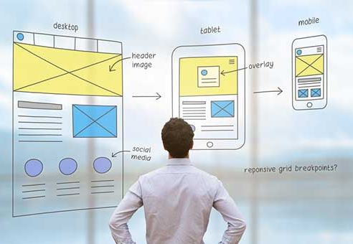
1.2 Difference of UI/UX Design
UI design is about the user interface and functionality of the entire product, and UX design is about the overall feeling of use of the entire product.
UX can apply to any kind of product, service, or experience; UI is specific to digital products and experiences.
Picture © https://transbiz.com.tw/ui-ux-design-difference/

Slide 14
UI/UX Design Example
1.3

Slide 15
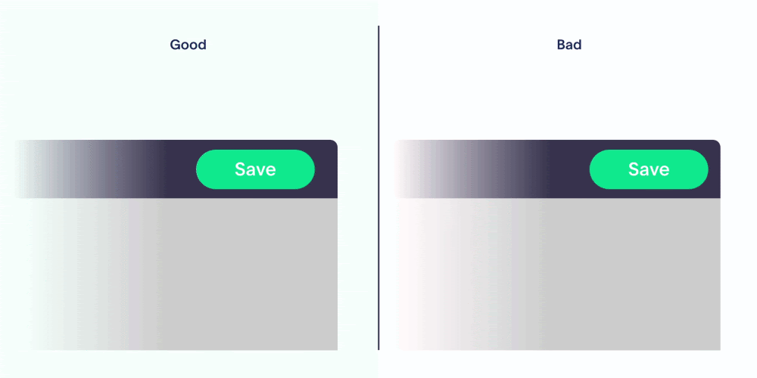
1.3 UI/UX Design Example
UX Design Example
Picture © https://xd.adobe.com/ideas/process/ui-design/good-bad-ux-design-examples/

Slide 16
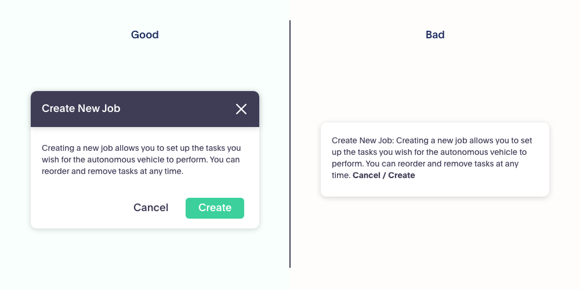
1.3 UI/UX Design Example
UX Design Example
Picture © https://xd.adobe.com/ideas/process/ui-design/good-bad-ux-design-examples/

Slide 17
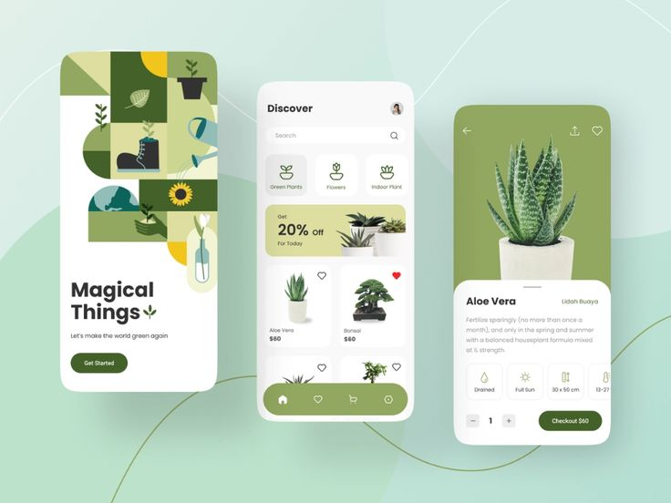
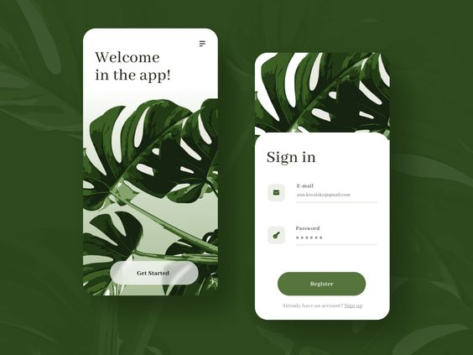
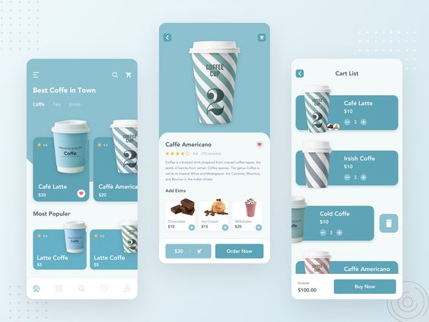
1.3 UI/UX Design Example
Good UI Design Example
Picture © https://dribbble.com/shots/15362803-Plant-Shop-App
Picture © https://dribbble.com/shots/14567712-Plants-Online-Shop
Picture © https://dribbble.com/shots/9711812-Coffee-App-UI-Exploration

Slide 18
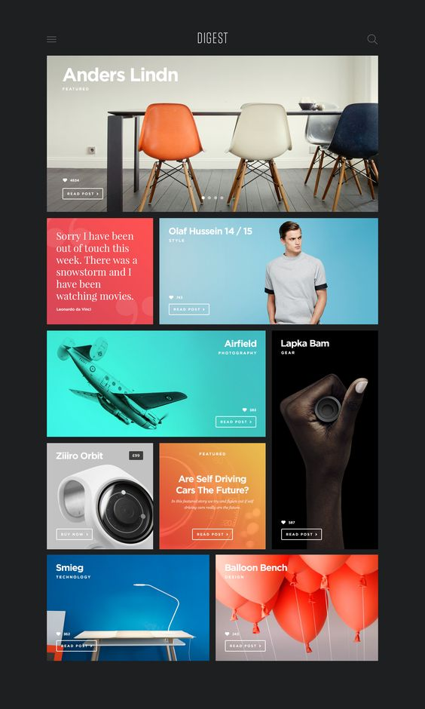
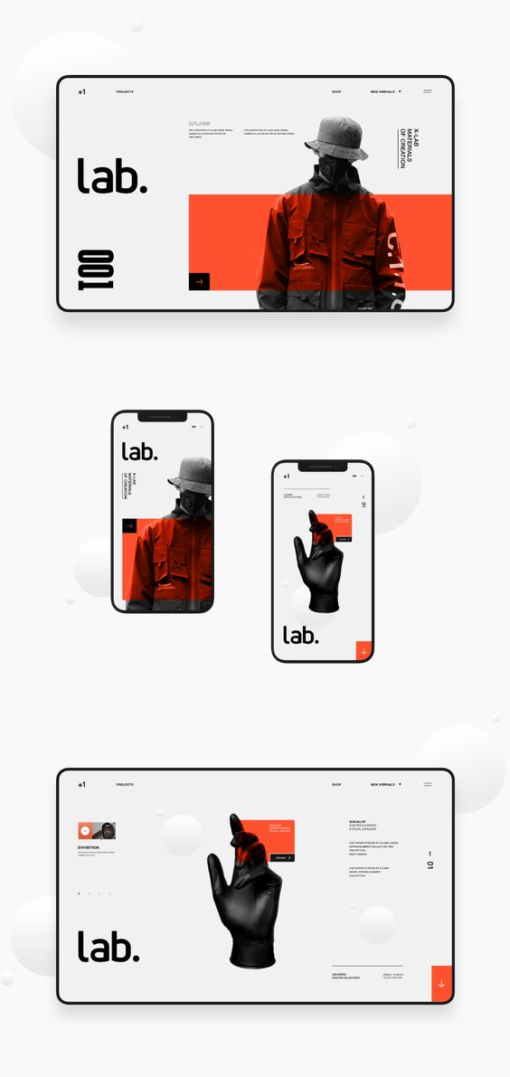
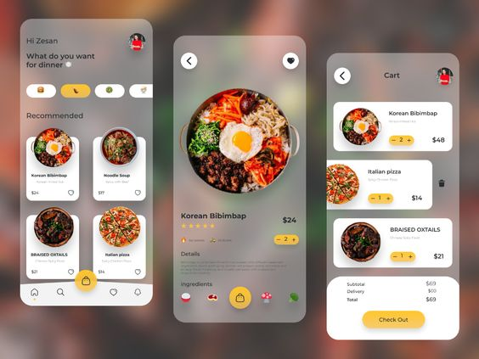
1.3 UI/UX Design Example
Good UI Design Example
Picture https://www.ideamotive.co/blog/dazzling-examples-of-mobile-app-ui-design
Picture © https://dribbble.com/shots/2079553-Digest-Magazine-Template-2/attachments/373534
Picture © https://inkbotdesign.com/what-makes-a-good-user-interface/

Slide 19
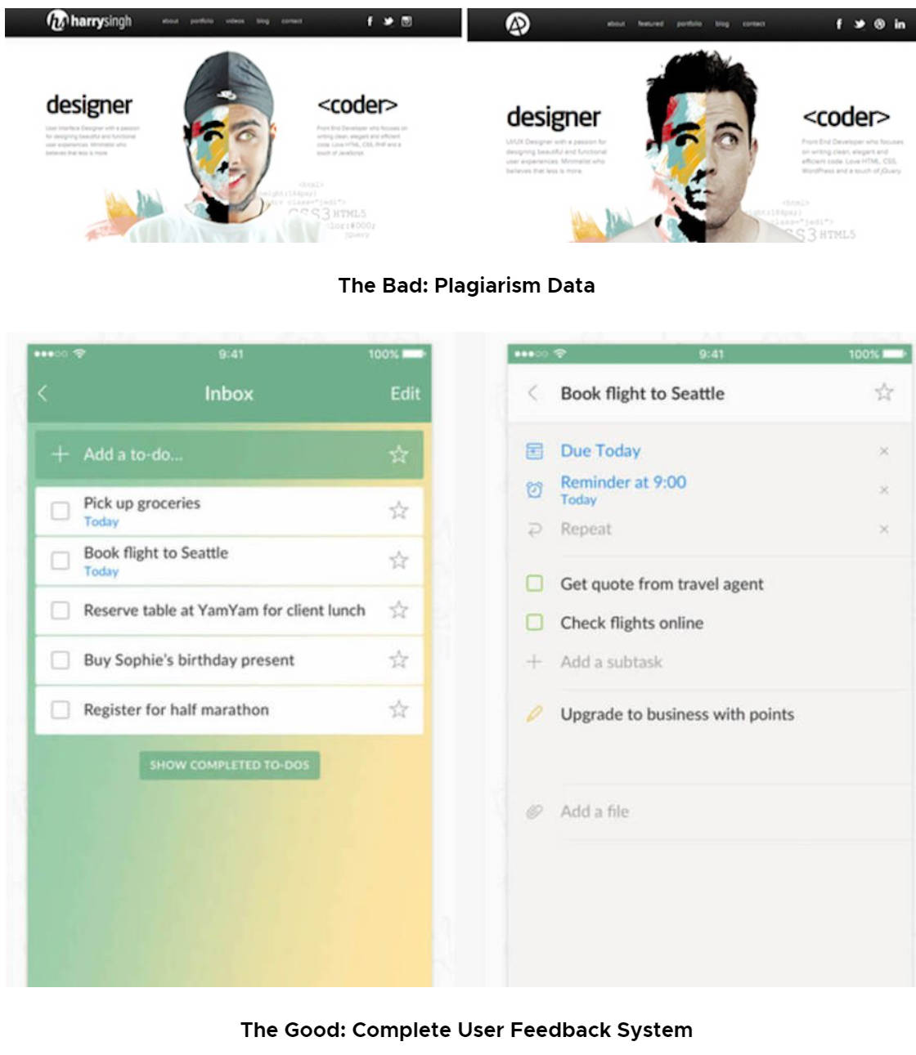
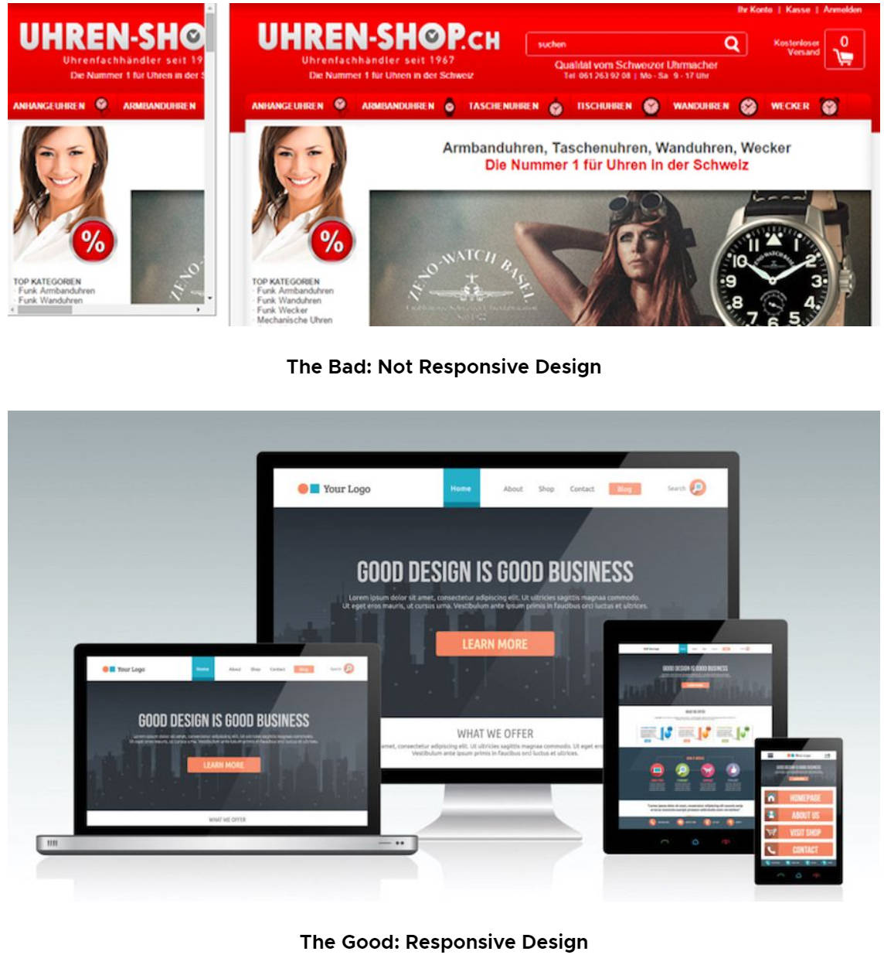
1.3 UI/UX Design Example
Bad UI Design Example
Picture © https://www.mockplus.com/blog/post/bad-ui-design-examples
Picture © https://www.mockplus.com/blog/post/bad-ui-design-examples

Slide 20
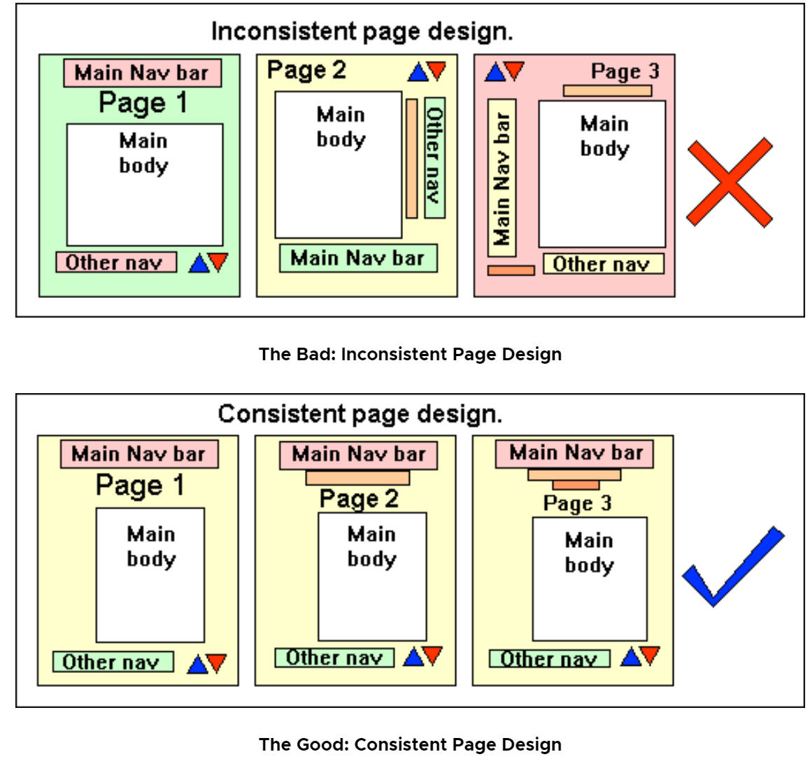
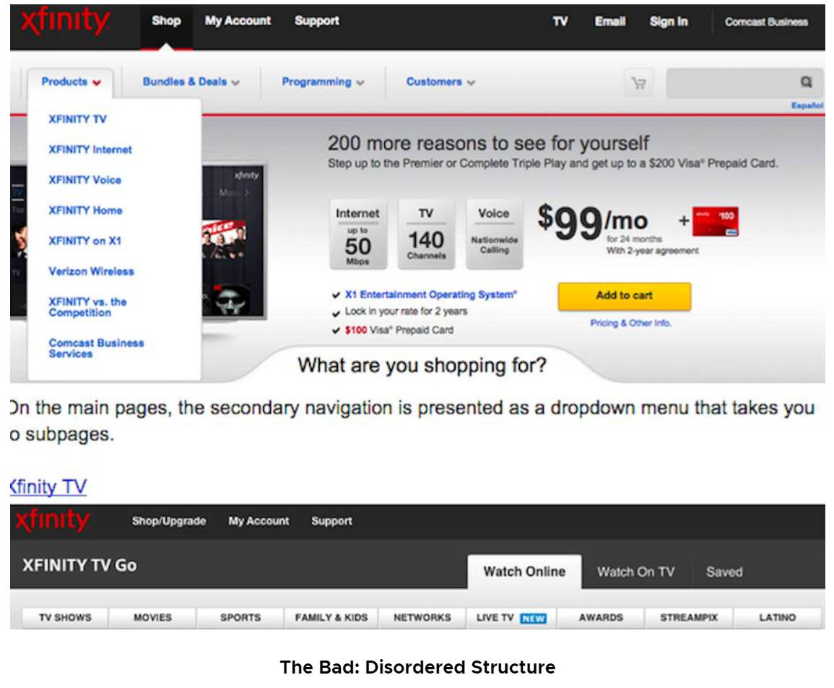
1.3 UI/UX Design Example
Bad UI Design Example
Picture © https://www.mockplus.com/blog/post/bad-ui-design-examples
Picture © https://www.mockplus.com/blog/post/bad-ui-design-examples

Slide 21
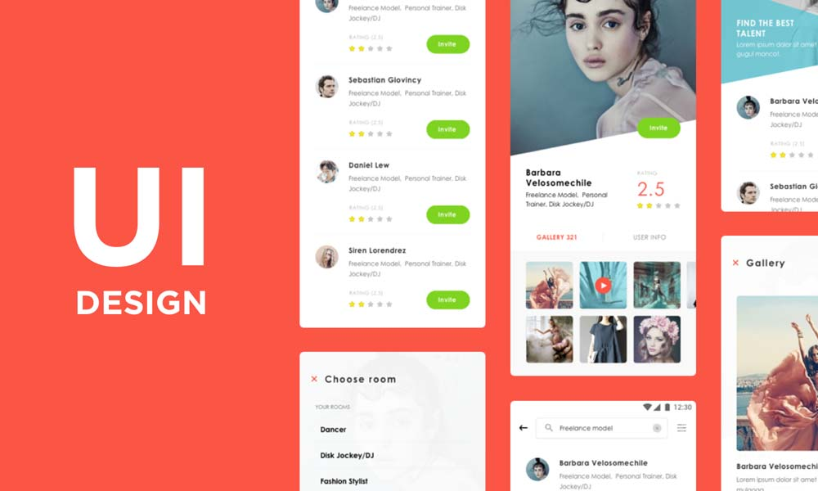
1.3 UI/UX Design Example
Good UI Design
Design visual and interactive elements
Create a user-friendly interface
Good use of icons, typography, spacing, color scheme
Picture © https://inkbotdesign.com/what-makes-a-good-user-interface/

Slide 22
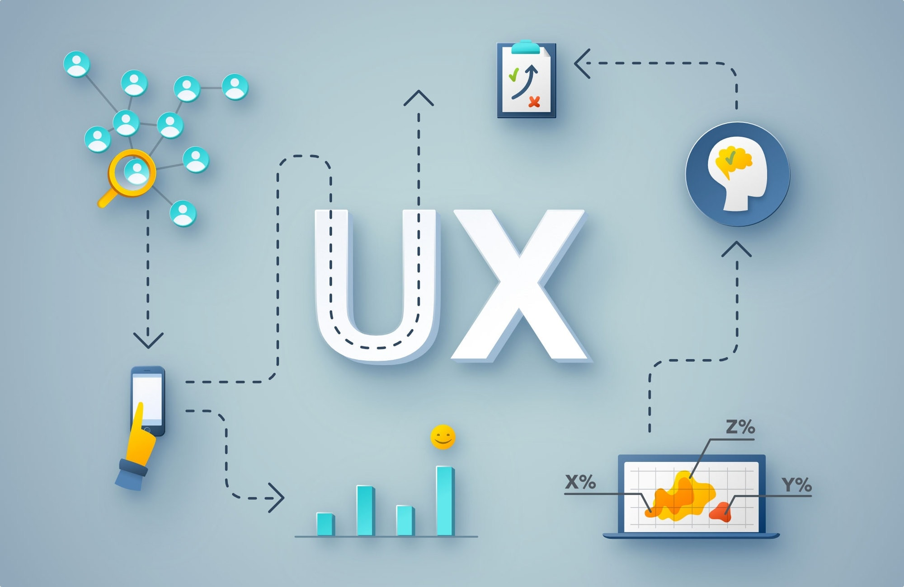
1.3 UI/UX Design Example
Good UX Design
Produce delightful and simple experience
Interactivity and functionality
Hierarchical Visual Design
Empathy and Simplicity
Adaptivity
Picture © https://www.outletgraphic.com/ux-design-become-service-design/

Slide 23
1.3 UI/UX Design Example
6 Bad UI Common Mistakes
The design lacks of contrast
Not-responsive design
No user feedback with plagiarism data
Bad IA (Information Architect)
Inconsistent style
Clunky and sluggish form

Slide 24
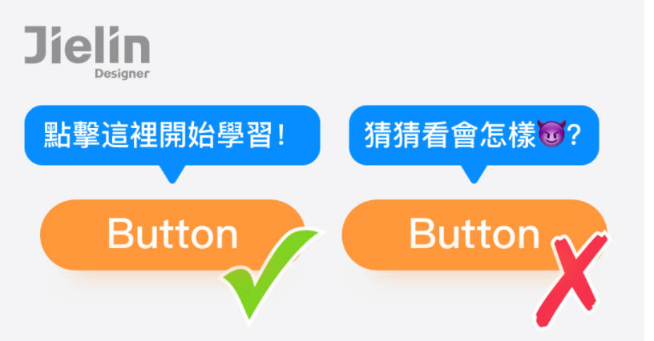
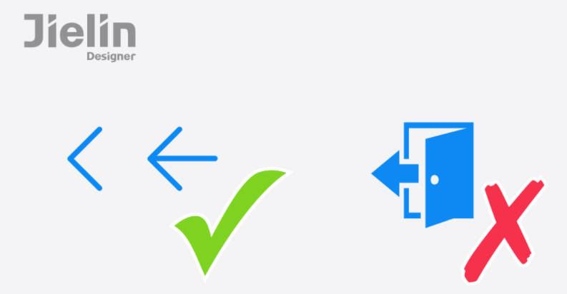
1.3 UI/UX Design Example
6 tips to increase the favorability of UI/UX design
1. Do not violate the user's established impression of certain functional icons
2. Intimate navigation instructions make it easier for users to enter the situation
Screenshot © jielin designer/https://haughty777.medium.com/ui-ux

Slide 25
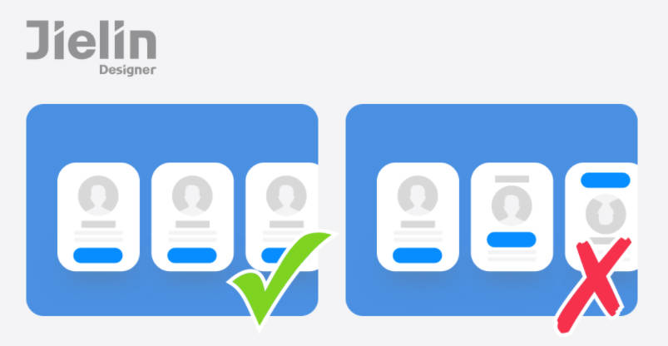
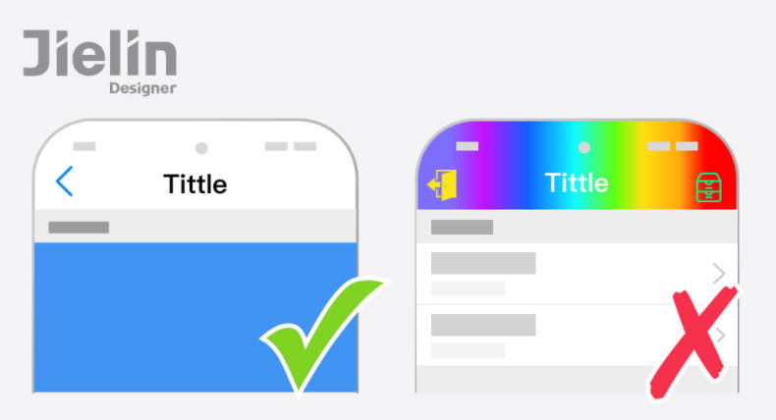
1.3 UI/UX Design Example
6 tips to increase the favorability of UI design
3. Consistent and standardized screen layout and element arrangement
4. Keep the picture as simple as possible to highlight the content
Screenshot © jielin designer/https://haughty777.medium.com/ui-ux

Slide 26
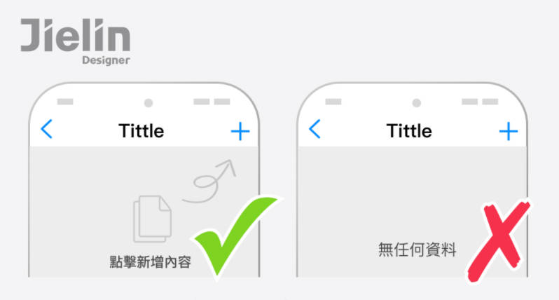
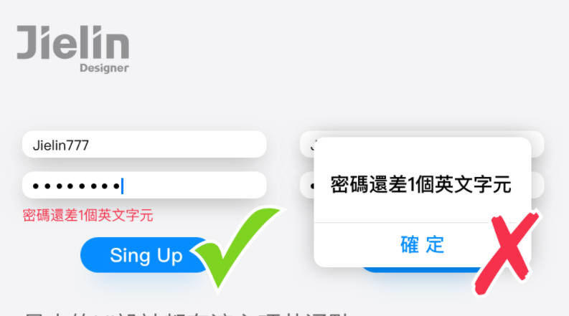
1.3 UI/UX Design Example
6 tips to increase the favorability of UI design
5. Never waste the power of a blank state
6. Prevent mistakes in advance and let users avoid mistakes
Screenshot © jielin designer/https://haughty777.medium.com/ui-ux

Slide 27
UI/UX Design Group Discussion
1.4

Slide 28
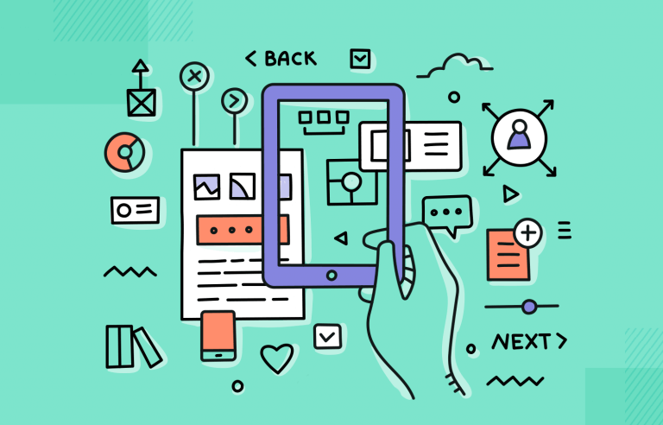
1.4 UI/UX Design Group Discussion
Activity:
Use 30 mins, Think about 2-3 daily mobile apps, a list of which apps have good UI/UX experience, and which apps do not have good UI/UX experience, and explain in detail.
Picture © https://www.justinmind.com/ux-design/principles

Slide 29
UI/UX Design Process
1.5

Slide 30
1.5 UI/UX Design Process
Research
Analysis
Design
Evaluation

Slide 31
1.5 UI/UX Design Process
Research
Analysis
Design
Evaluation

Slide 32

1.5 UI/UX Design Process
User Research (UX)
5W1H , Who, what, where, when, why and how.
1. Who is the user?
2. What does the user need to know?
3. Where is the user in an experience?
4. When do users need this information?
5. Why do you stand behind the words you chose?
6. How should you say it?

Slide 33
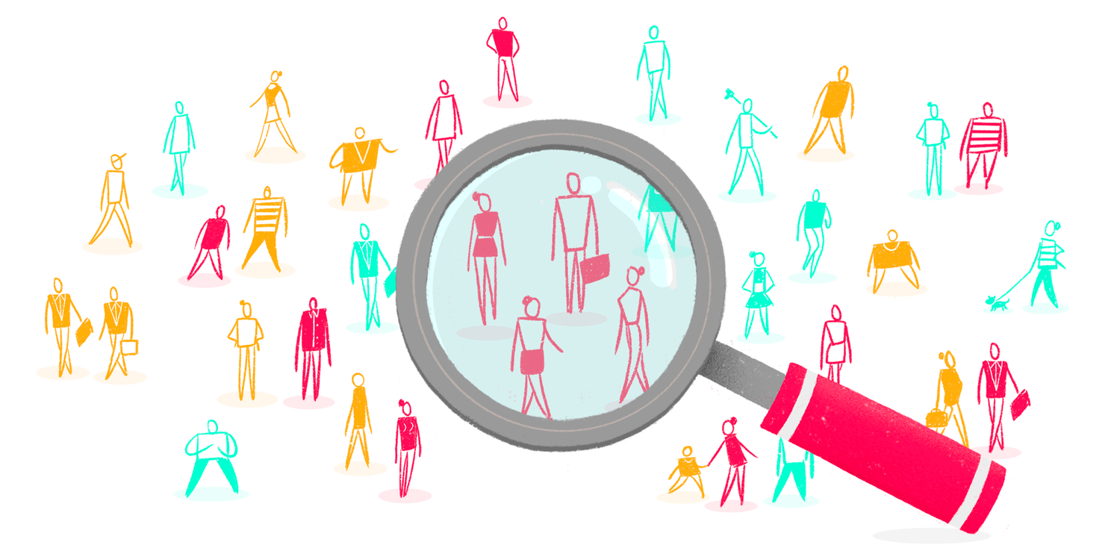
1.5 UI/UX Design Process
Market Research (UX)
Understand the industry standards and the design trends
Find out the opportunity gap
Learn about the apps with the highest market share

Slide 34
1.5 UI/UX Design Process
Research
Analysis
Design
Evaluation

Slide 35
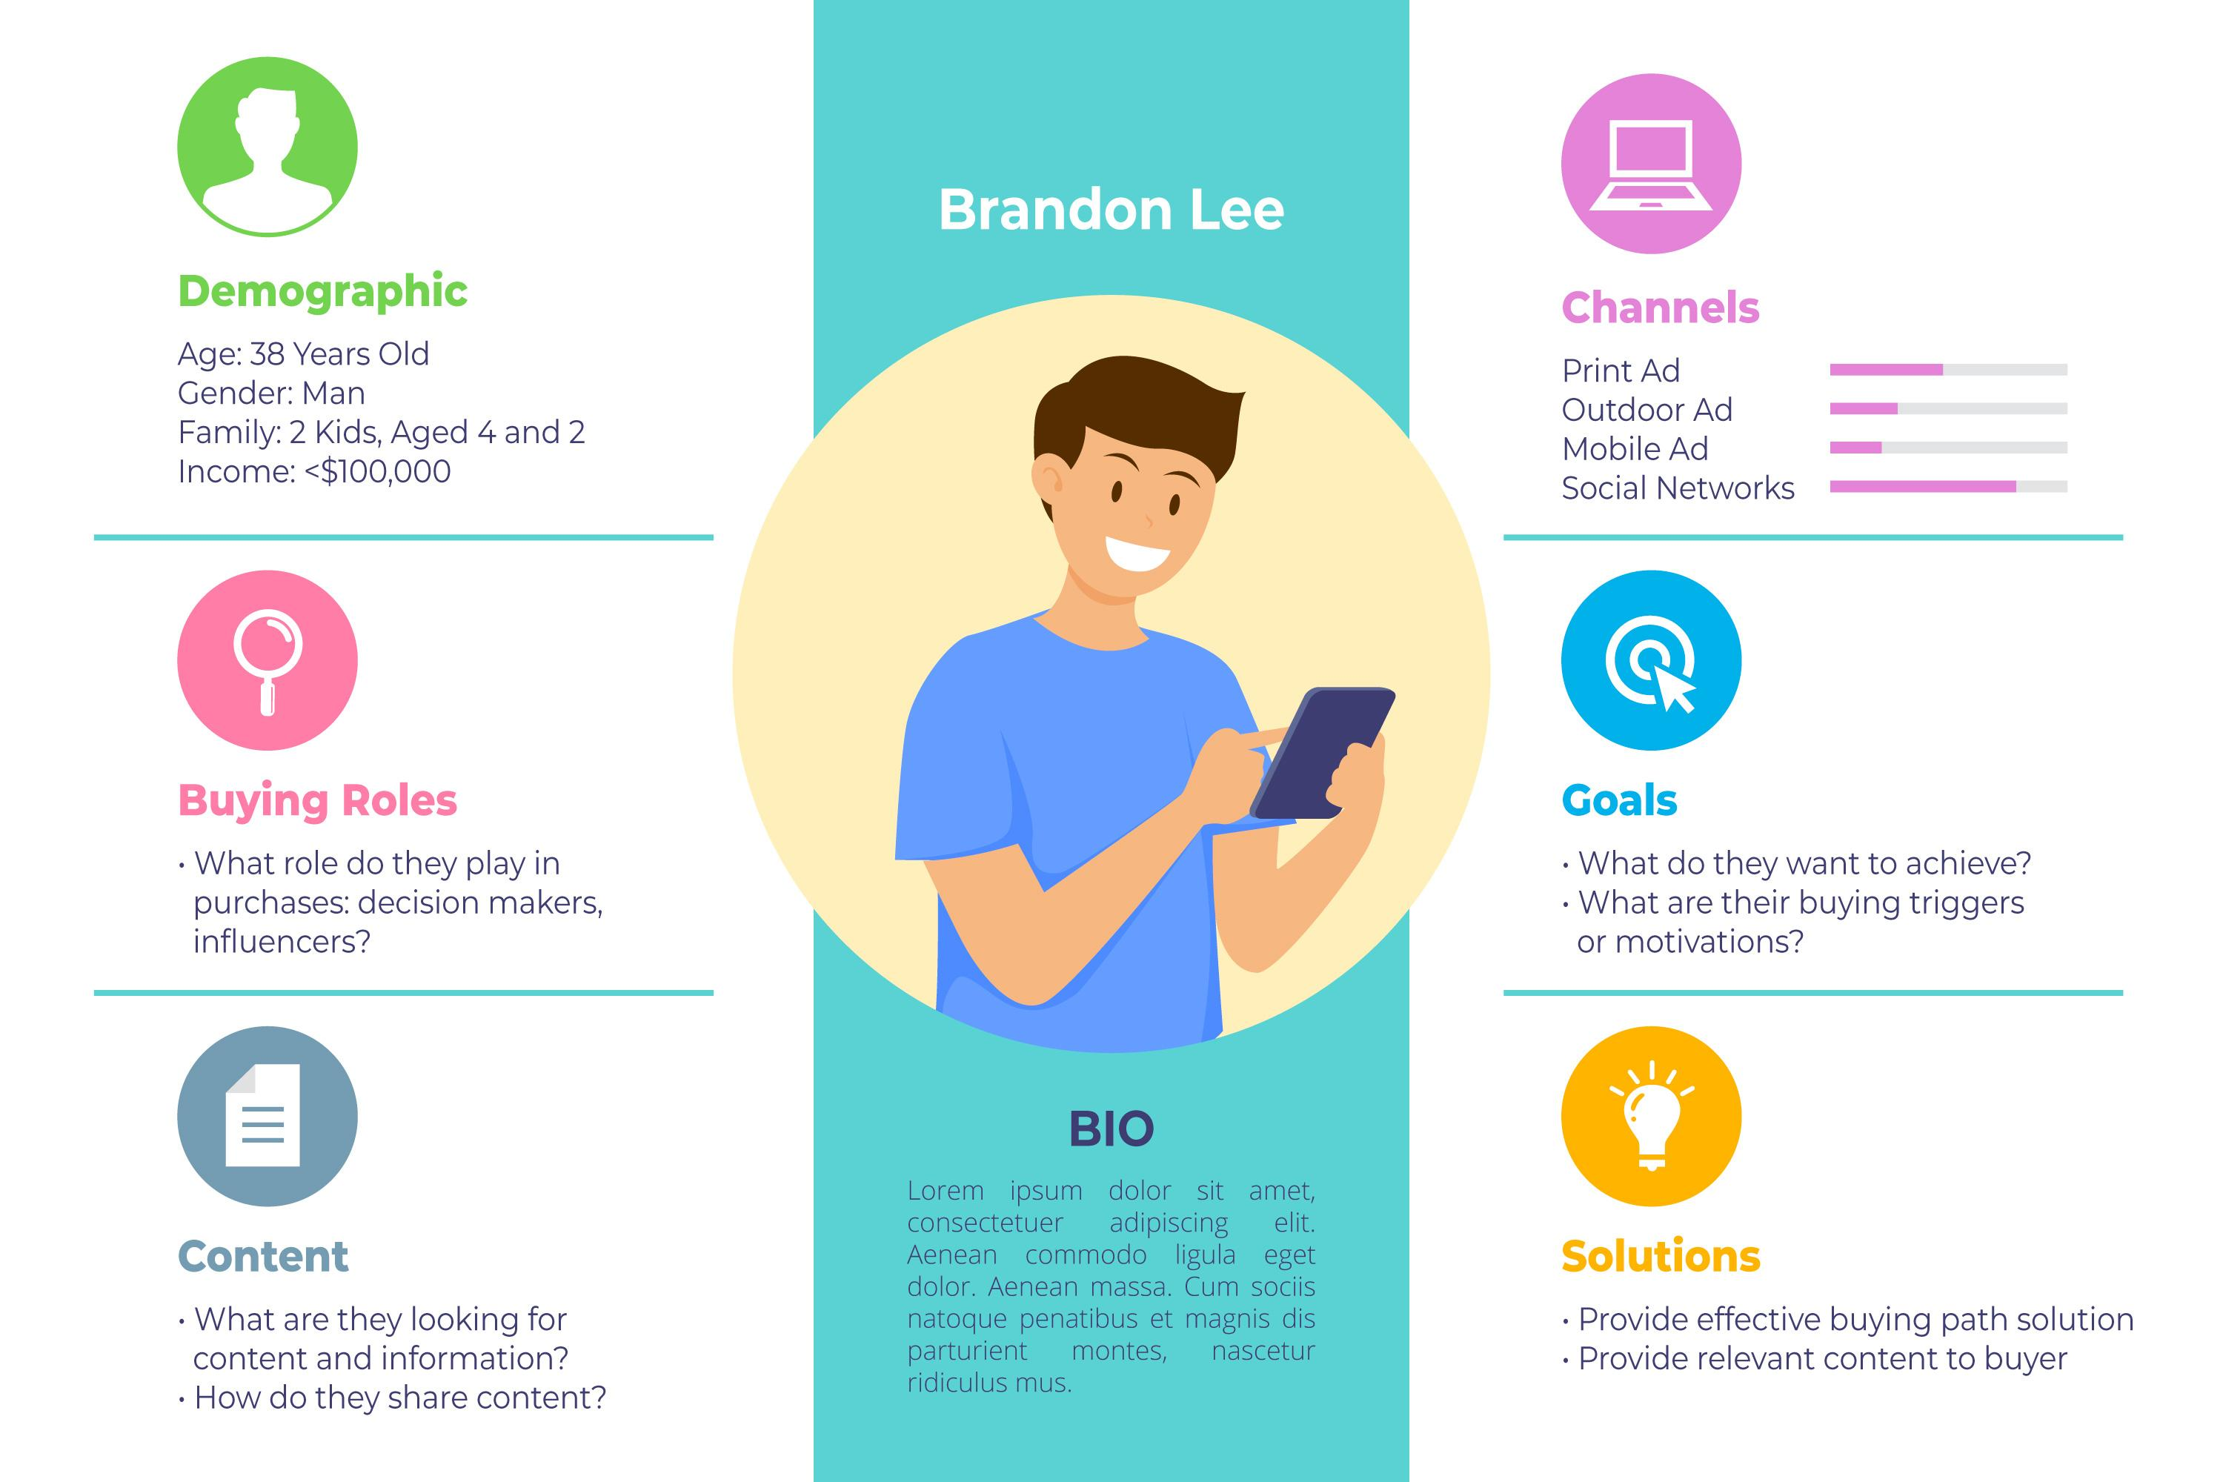
1.5 UI/UX Design Process
UX Design Persona

Slide 36
1.5 UI/UX Design Process
UX Design Persona
User personas are archetypical users whose goals and characteristics represent the needs of a larger group of users. Usually, a persona is presented in a one or two-page document Such 1–2-page descriptions include behavior patterns, goals, skills, attitudes, and background information, as well as the environment in which a persona operates. Designers usually create user persona template templates, which include a few fictional personal details to make the persona a realistic character.

Slide 37
1.5 UI/UX Design Process
UX Design Persona
Why are user personas important?
A deep understanding of a target audience is fundamental to creating exceptional products. User personas help a product team find the answer to one of their most important questions, “Who are we designing for?” By understanding the expectations, concerns, and motivations of target users, it’s possible to design a product that will satisfy users’ needs and therefore be successful.

Slide 38
1.5 UI/UX Design Process
Project Brief (UX)
Project brief defines the who, what, when, where, and why,
setting clear expectations for stakeholders on the front end.
Project Deadline Design Requirements
Project Overview Required color palette
Goals and Objectives Image assets to be included
Target Audience

Slide 39
1.5 UI/UX Design Process
Research
Analysis
Design
Evaluation

Slide 40
1.5 UI/UX Design Process
Research
Analysis
Design
Evaluation

Slide 41
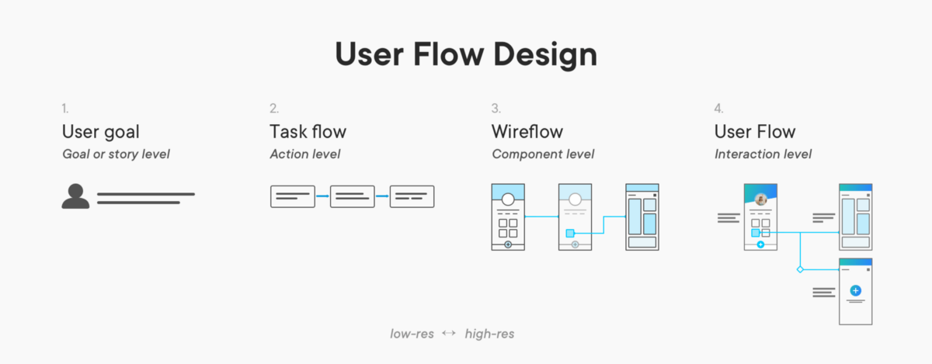
1.5 UI/UX Design Process
Show the complete usage movements and shape the customer journey map

Slide 42
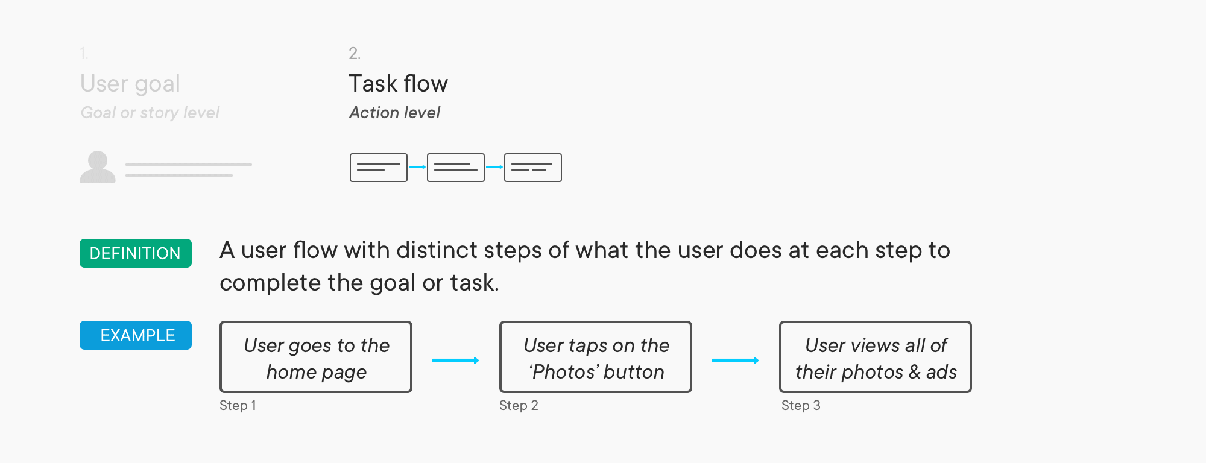
1.5 UI/UX Design Process
Step.2

Slide 43
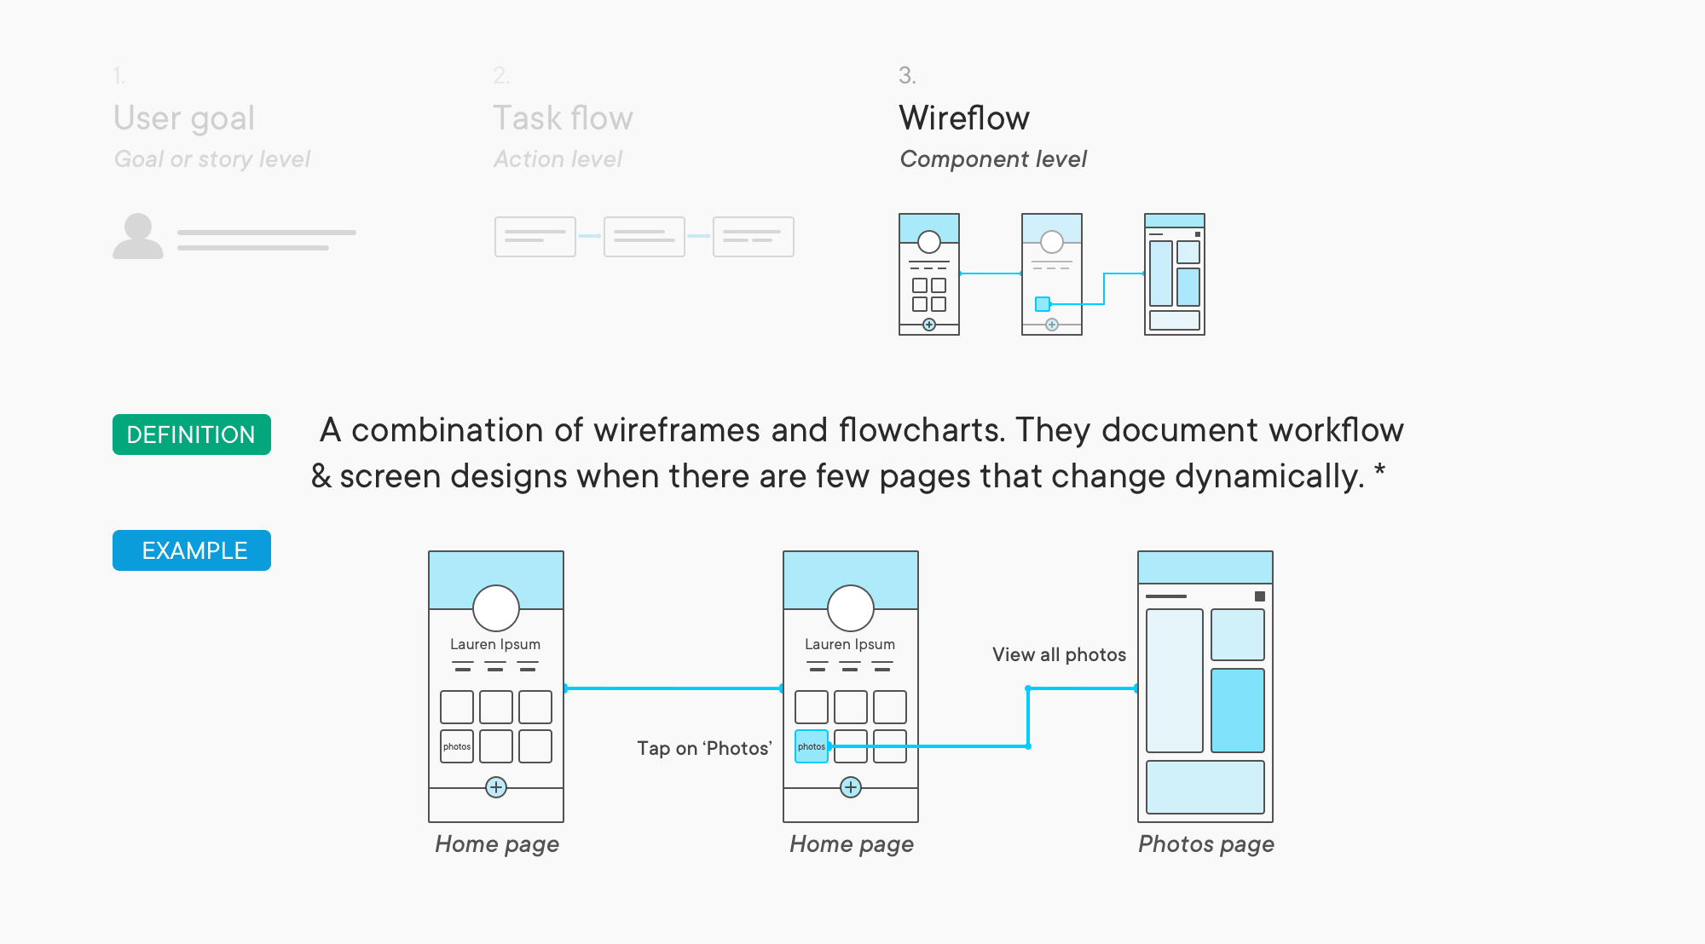
1.5 UI/UX Design Process
Step3.

Slide 44
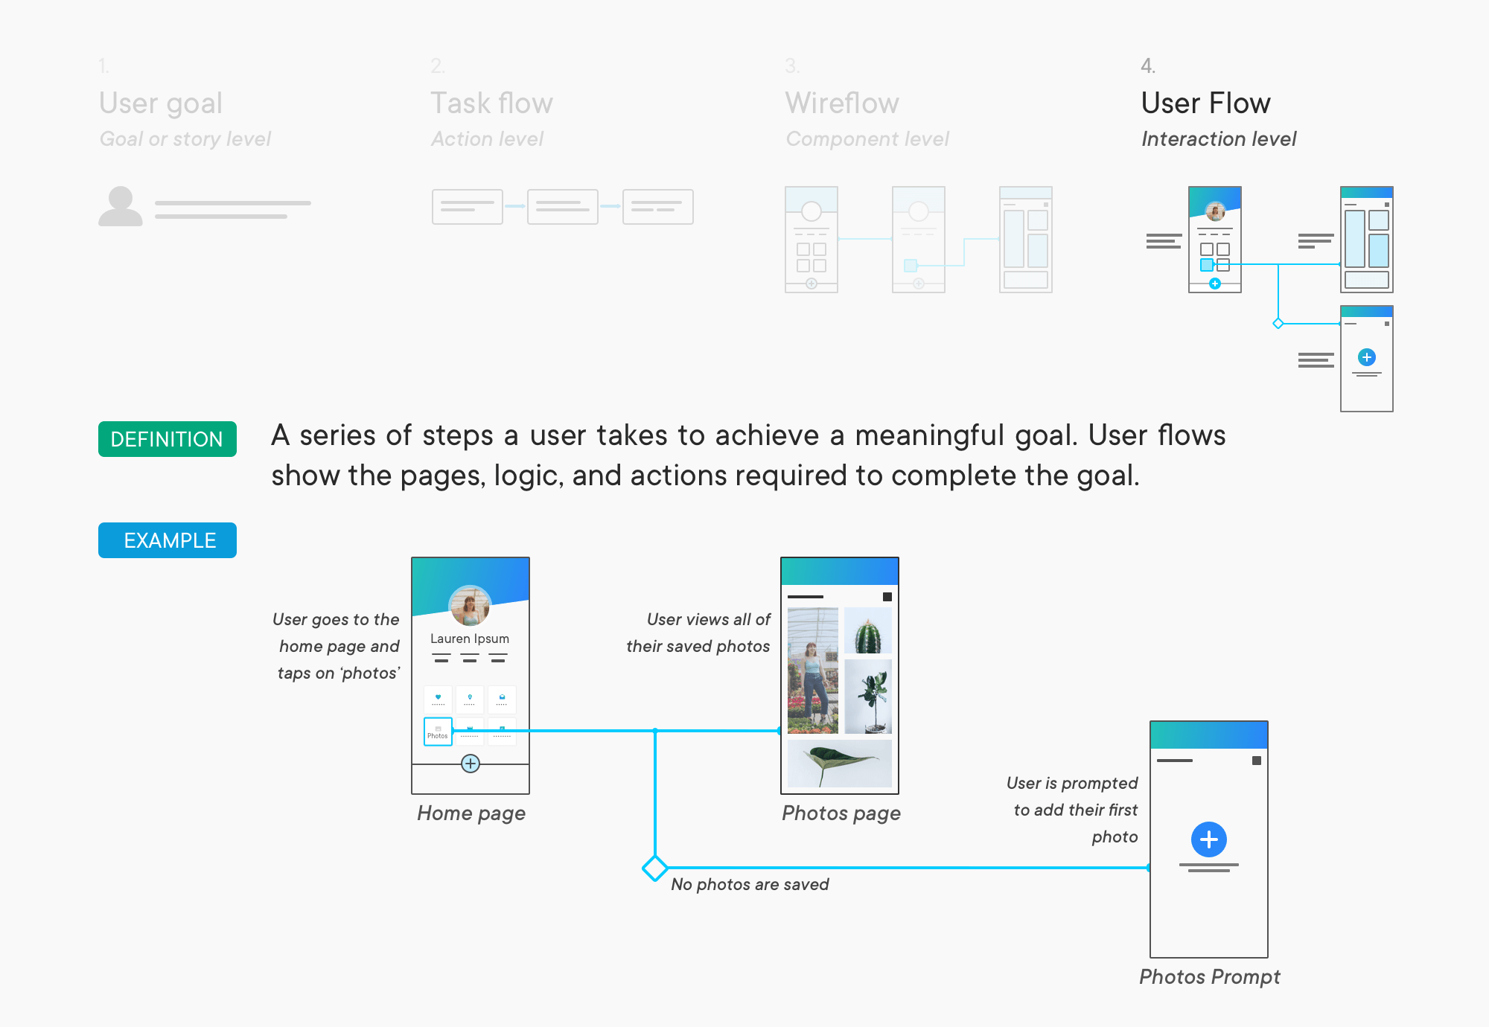
1.5 UI/UX Design Process
Step4.

Slide 45
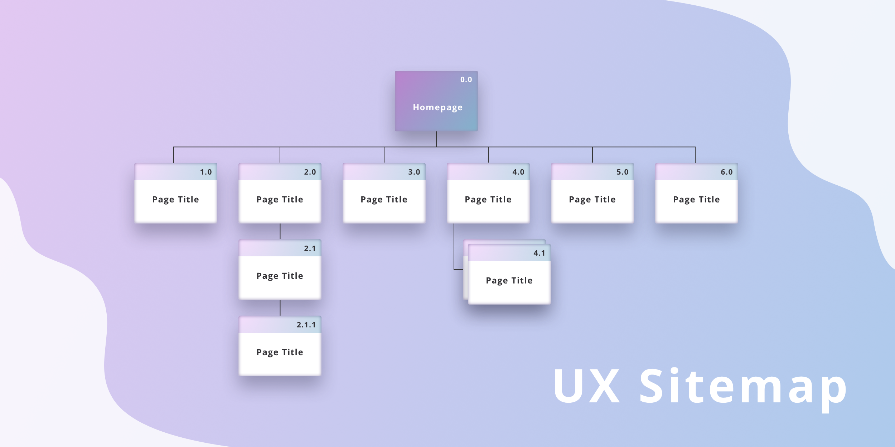
1.5 UI/UX Design Process
Site Map

Slide 46
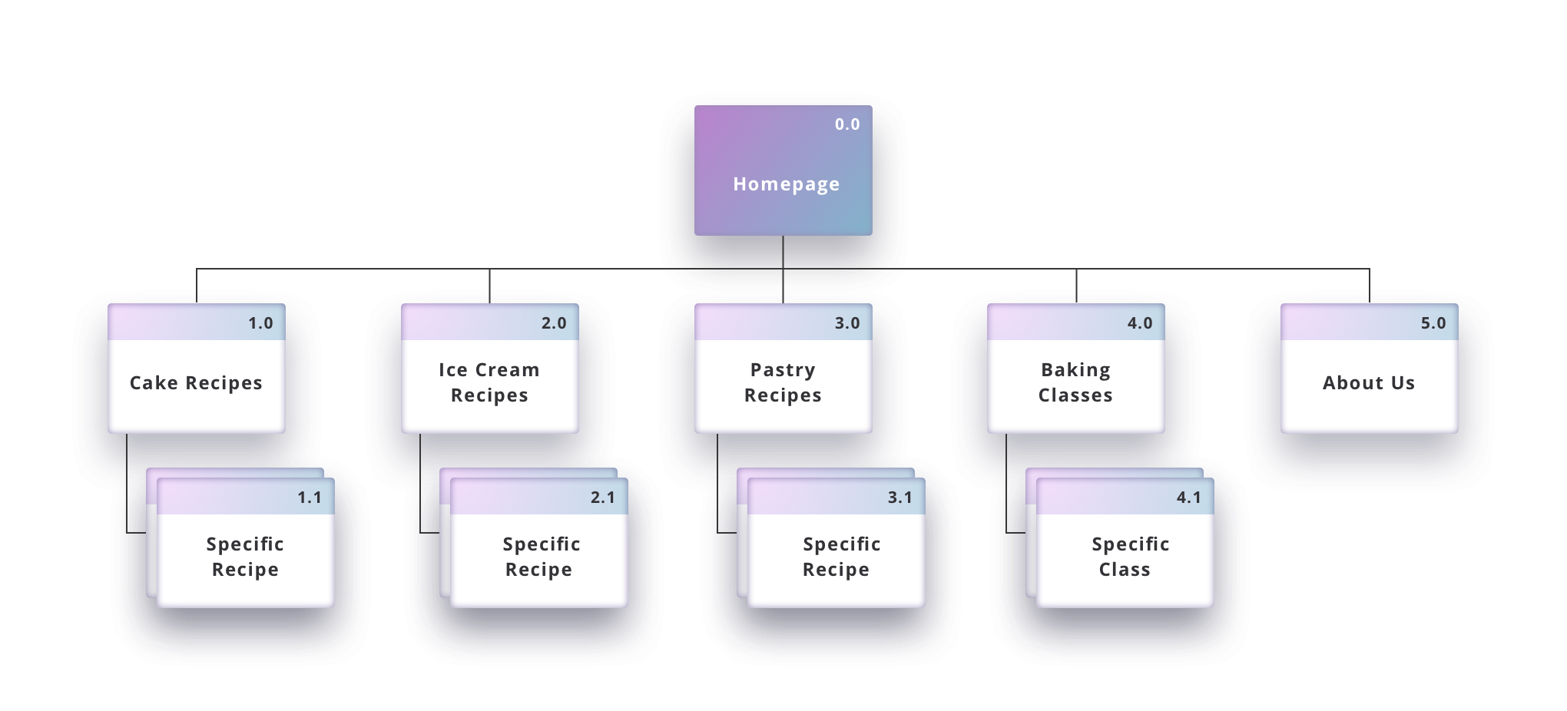
1.5 UI/UX Design Process

Slide 47
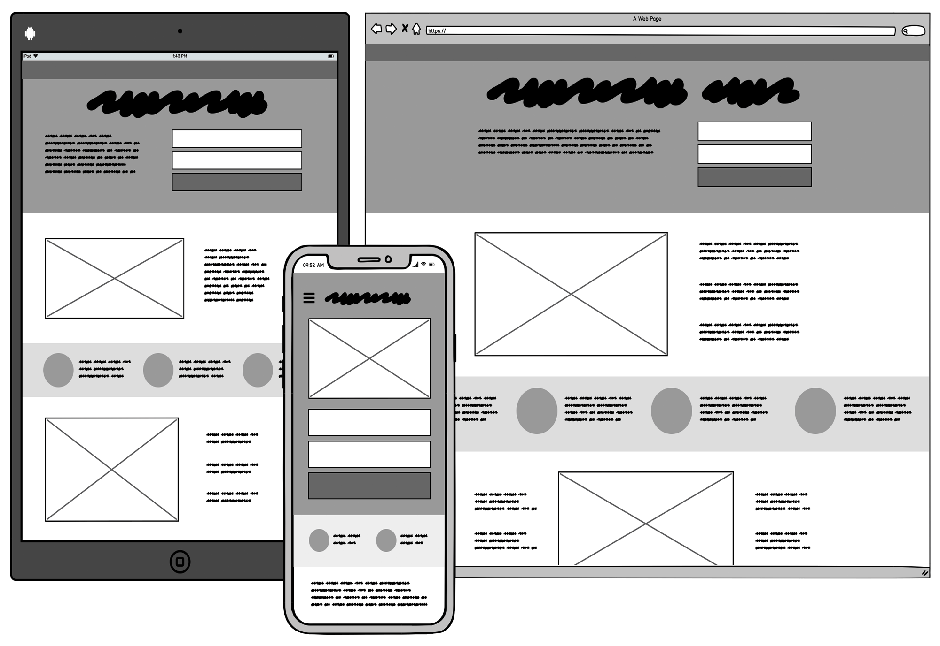
1.5 UI/UX Design Process
UX Design: Wireframing
Wireframing is a practice used by UX designers which allows them to define and plan the information hierarchy of their design for a website, app, or product.
Provides a structural sample to define the information content
Minimize rework and test functionality and usability

Slide 48
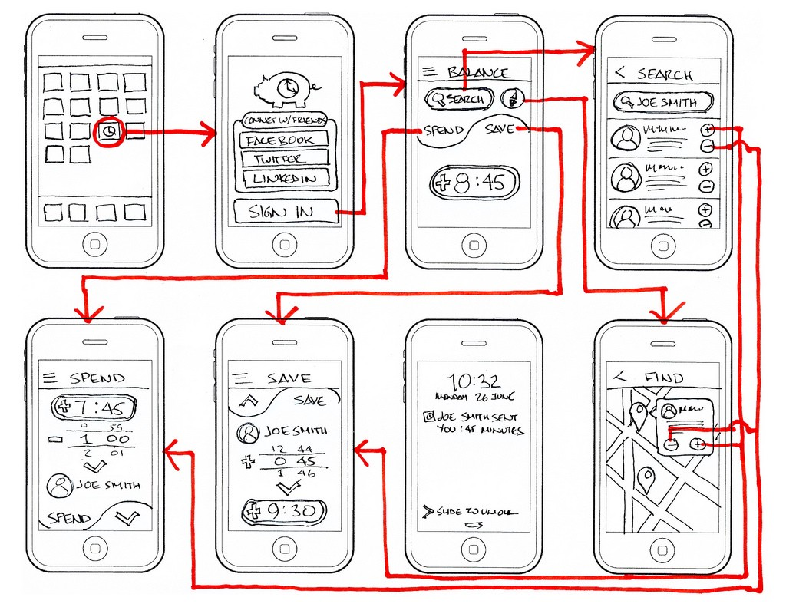
1.5 UI/UX Design Process

Slide 49
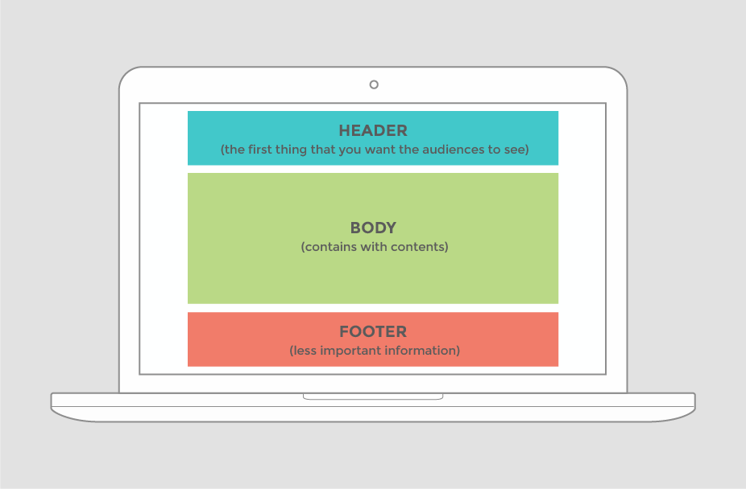
1.5 UI/UX Design Process
UX Design: Structure of Website

Slide 50
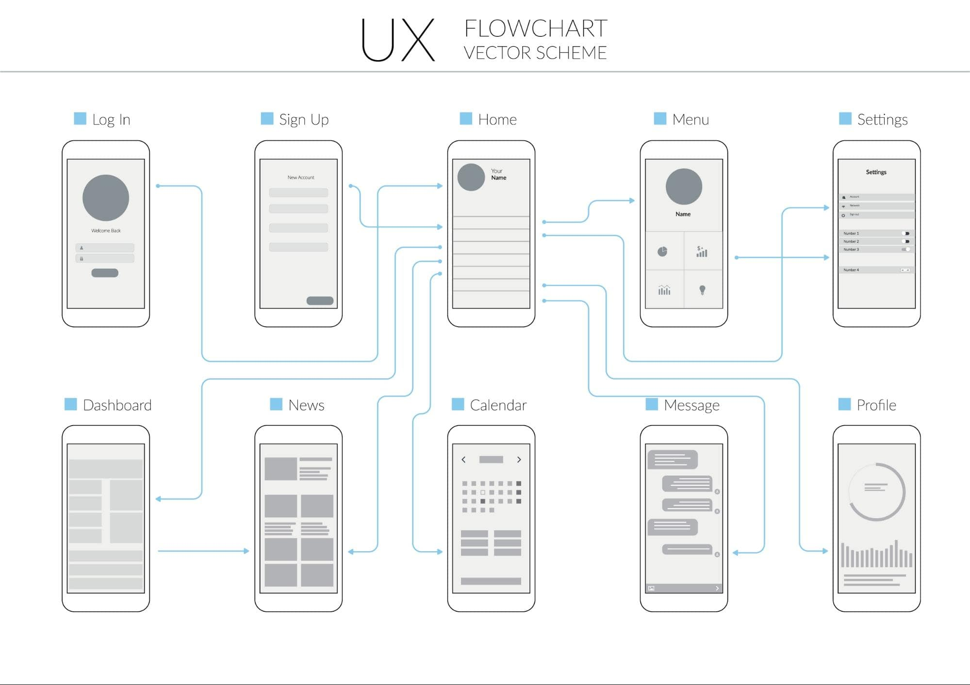
1.5 UI/UX Design Process
UX Design: Structure of mobile app

Slide 51

1.5 UI/UX Design Process

Slide 52
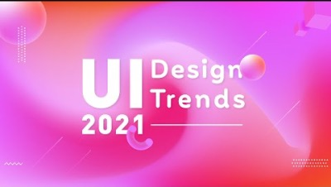
1.5 UI/UX Design Process

Slide 53
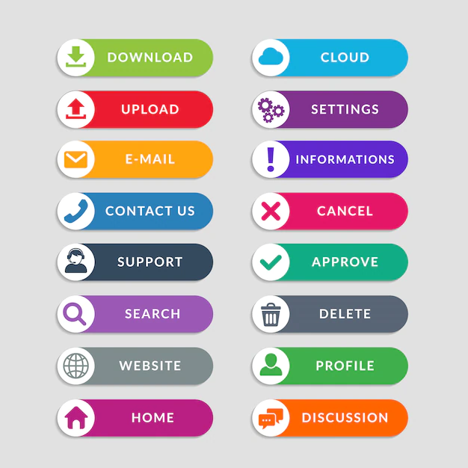
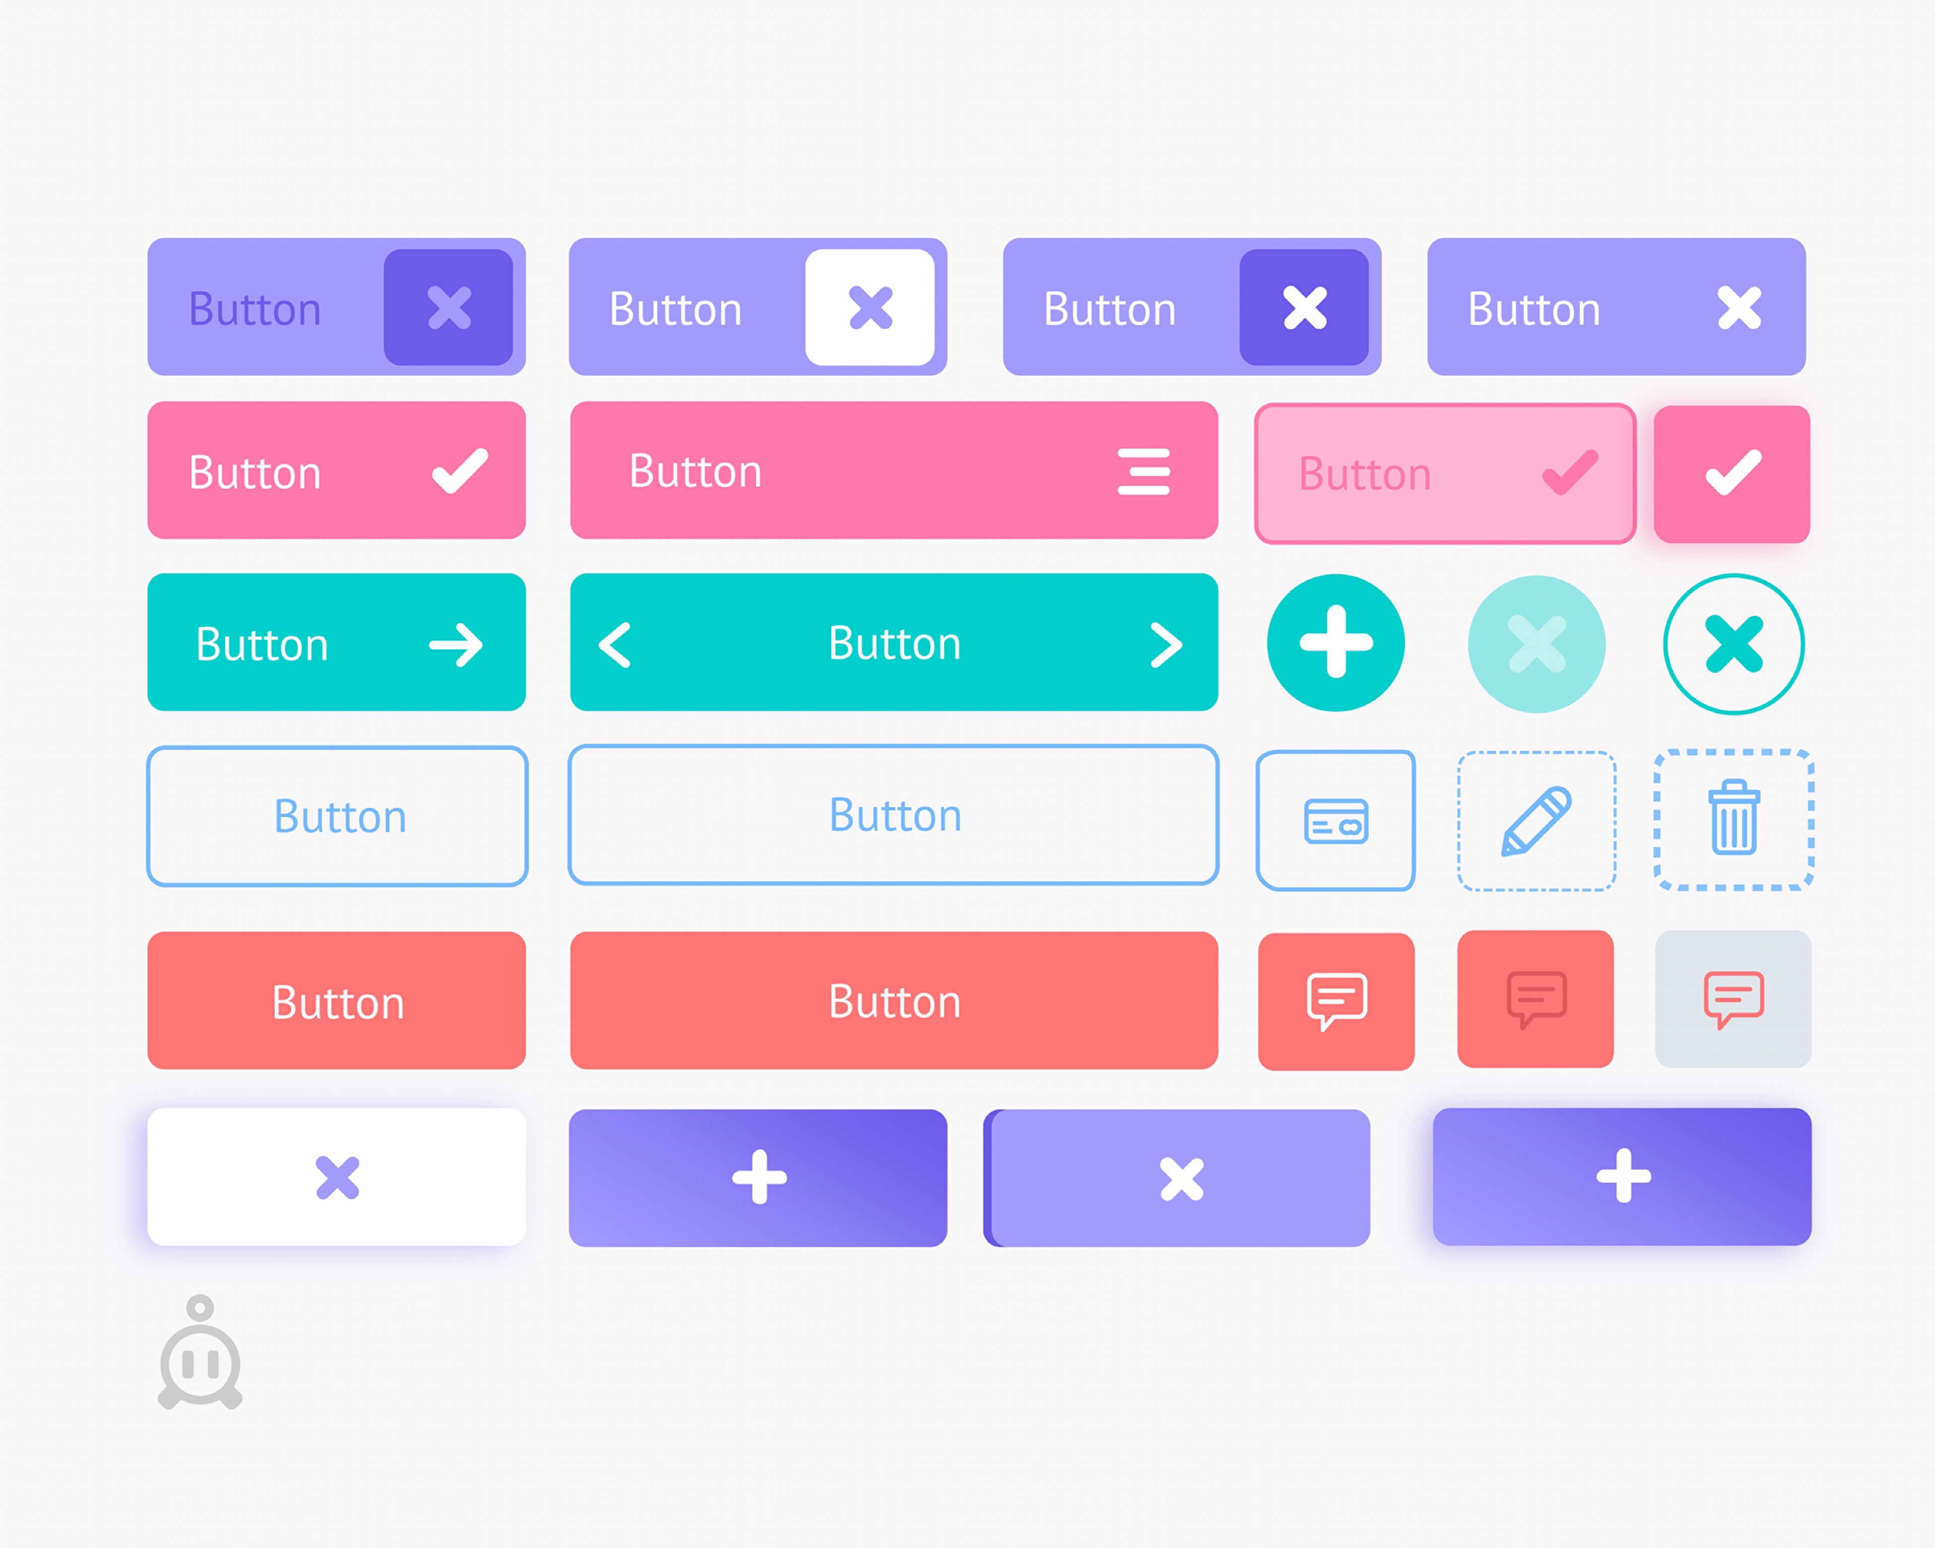
1.5 UI/UX Design Process
UI Design: Button Design
Applied to different kinds of UI design, corresponding buttons in line with the theme design, plain color with text, icon with text, icon with text, and color with light and shadow

Slide 54
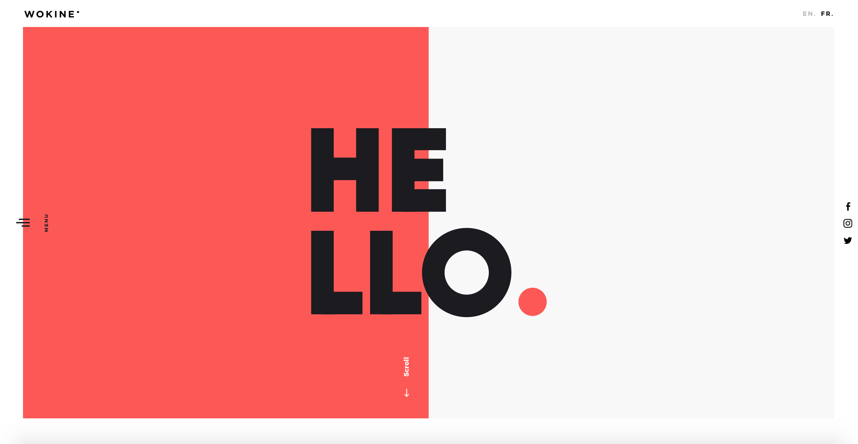
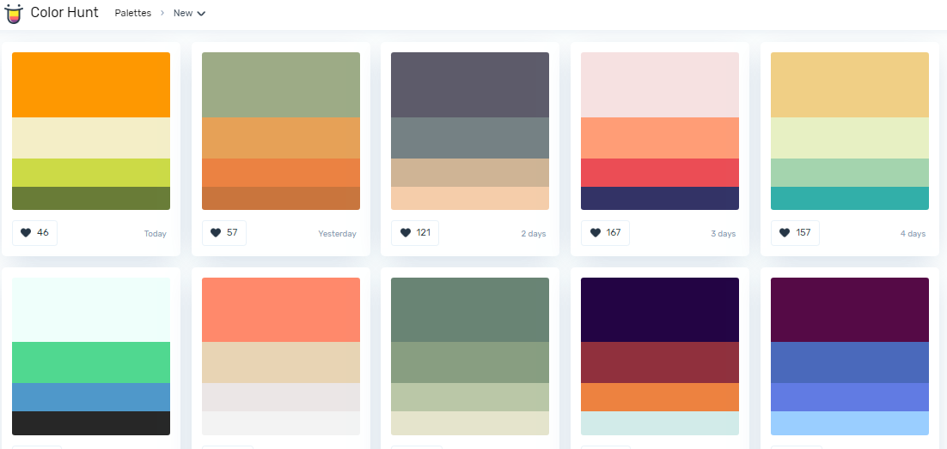
1.5 UI/UX Design Process
UI Design: Color Scheme
Modern, attractive, and consistence, can match the theme of the product.

Slide 55
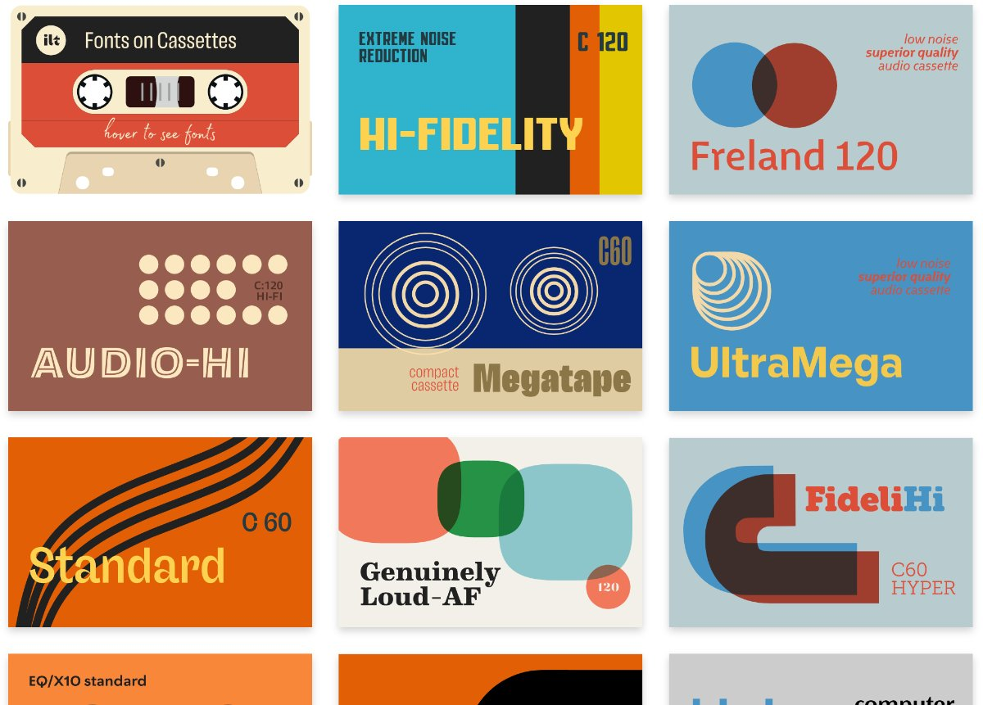
1.5 UI/UX Design Process
UI Design: Typography
Commonly, typography is defined as the art and science of font style, appearance, and structure which aims at delivering the aesthetic and easily readable copy to readers

Slide 56
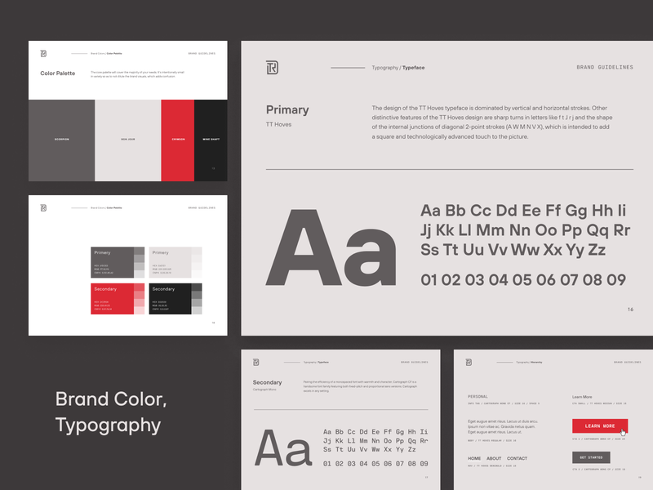
1.5 UI/UX Design Process
UI Design: Typography
Develop a strong visual hierarchy
Enhance the consistency
Optimize readability and accessibility
Deliver a satisfying user experience

Slide 57
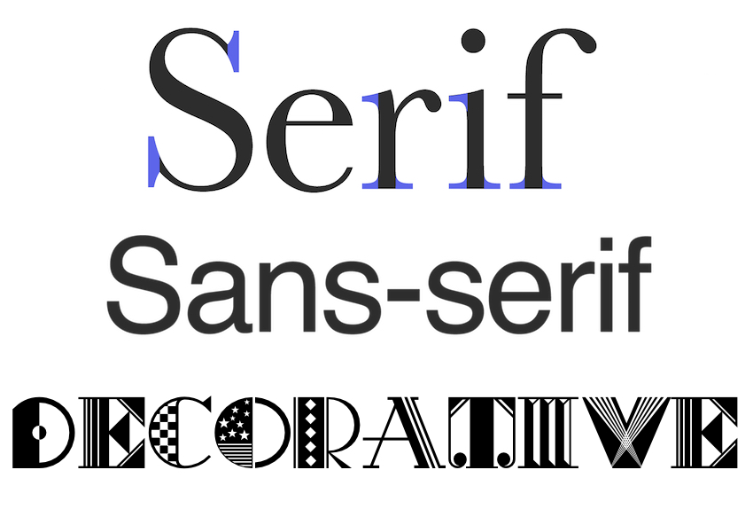
1.5 UI/UX Design Process
UI Design: Typography
Think about the personality
Reflect on tone
Don’t skimp on function
Consider performance
Get inspired

Slide 58
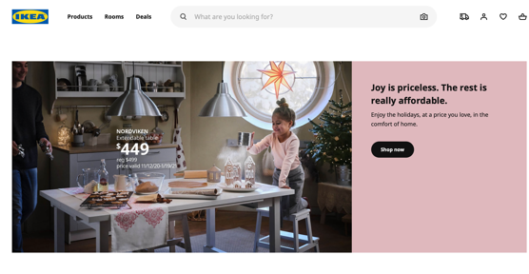
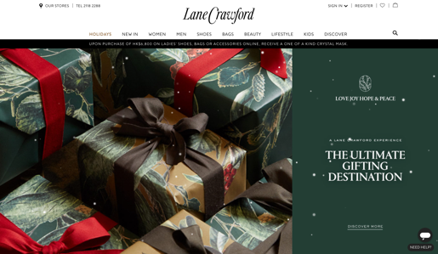
1.5 UI/UX Design Process
UI Design: Typography example

Slide 59
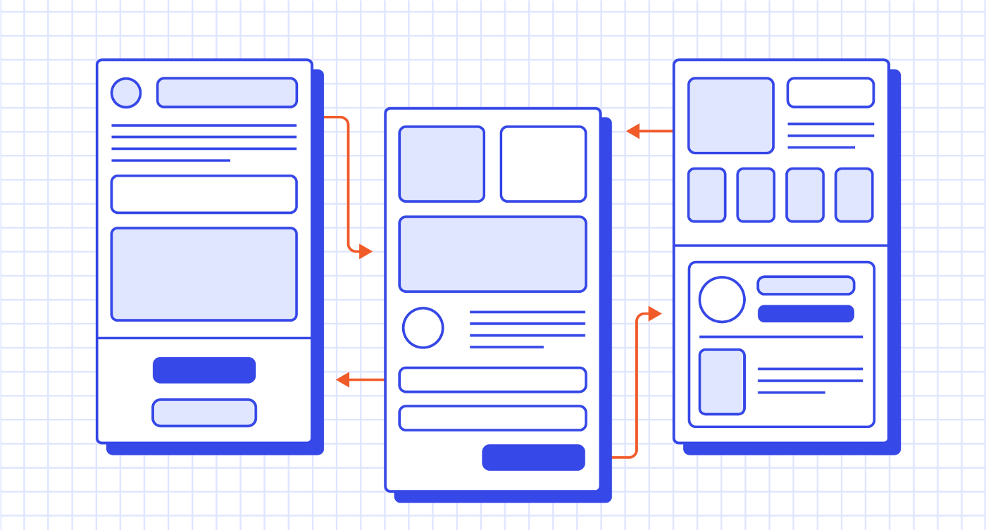
1.5 UI/UX Design Process
UX Design: Prototype
Prototypes are a close replica of what the end result of a product will look like, usually without code. They incorporate most of the final UI design and interaction that the finished product will have.

Slide 60
1.5 UI/UX Design Process
Research
Analysis
Design
Evaluation

Slide 61
1.5 UI/UX Design Process
Evaluation: Feedbacks
Set a procedure and clear expectations
Start early and ask questions
Be open-minded and don’t take it as personal issue
Clarify and discover the cause root
Show better solutions and understand how to justify them
Take praise and accept feedbacks

Slide 62
1.5 UI/UX Design Process
Evaluation: Feedbacks
Identify feedback loops of the product
Understand the components of the loops
Speed
Measurability
Context
Connection to motivations

Slide 63
Class Exercise
1.6

Slide 64
1.6 Class Exercise
Solution: Now you are a UX designer, now you have designed a shopping app product, try to use the 5w1h method to think about the User, market, and Persona of your product.
Min: 30mins

Slide 65
Free UI/UX Design Resources
1.7

Slide 66
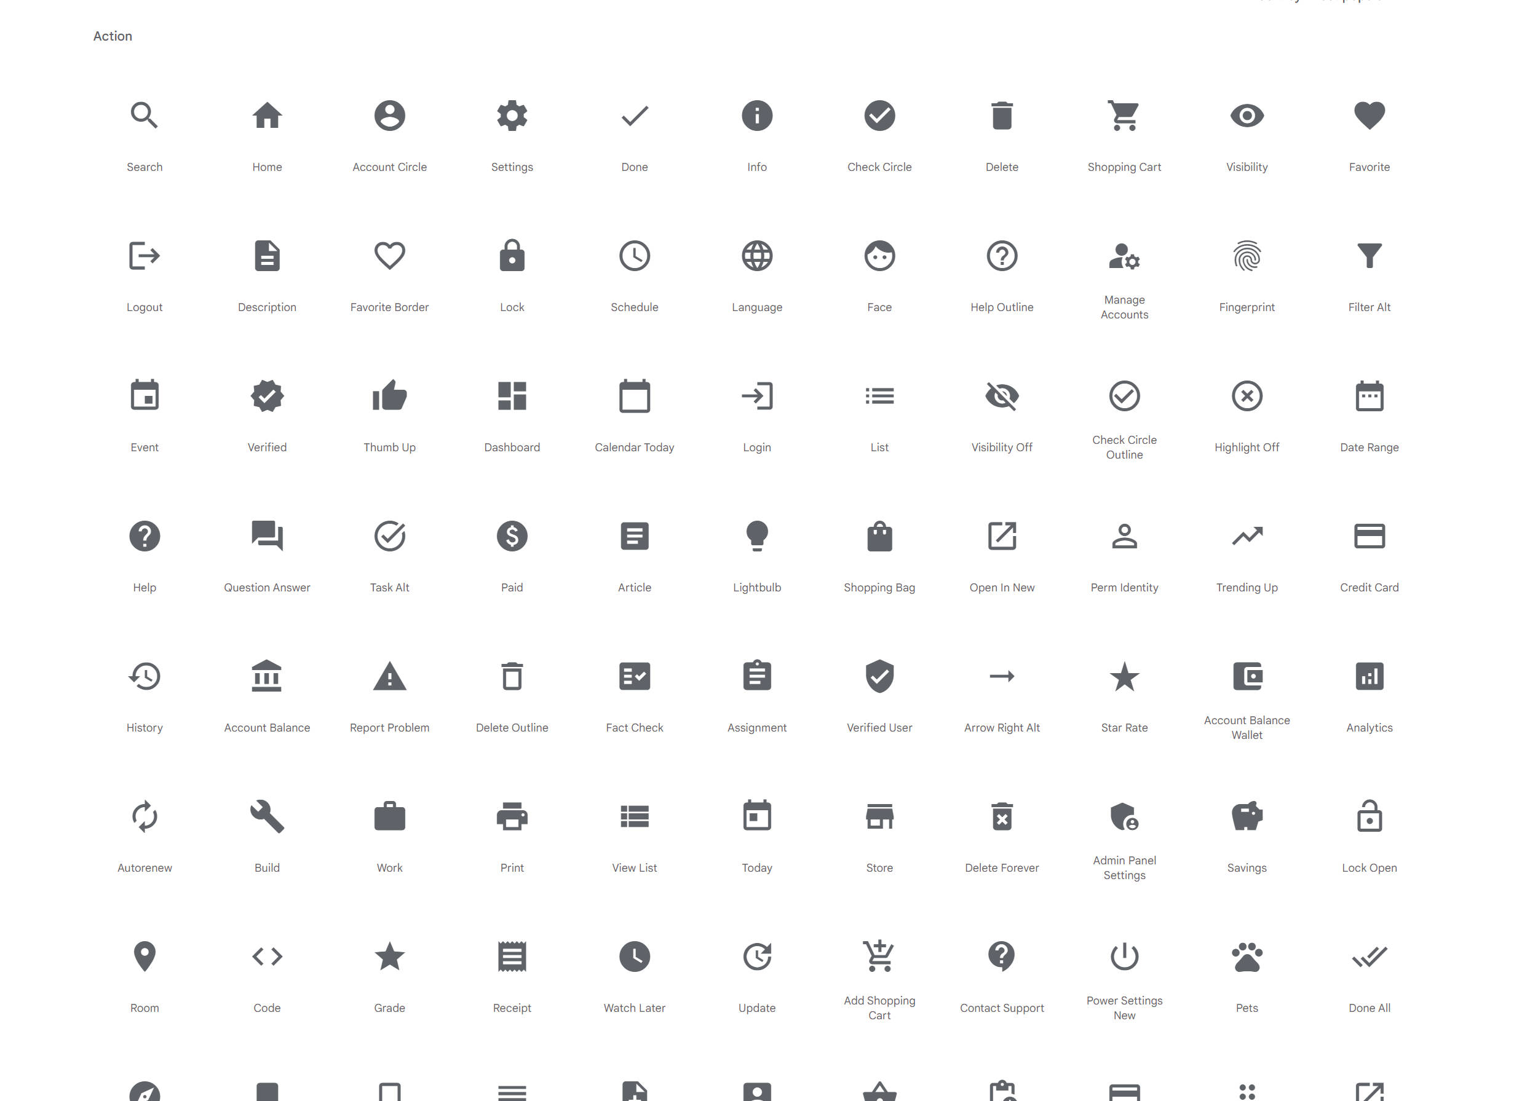
1.7 Free UI/UX Design Resources
https://fonts.google.com/icons?selected=Material+Icons
Material Icons are available in five styles and a range of downloadable sizes and densities. You can download for using UI/UX design material.

Slide 67
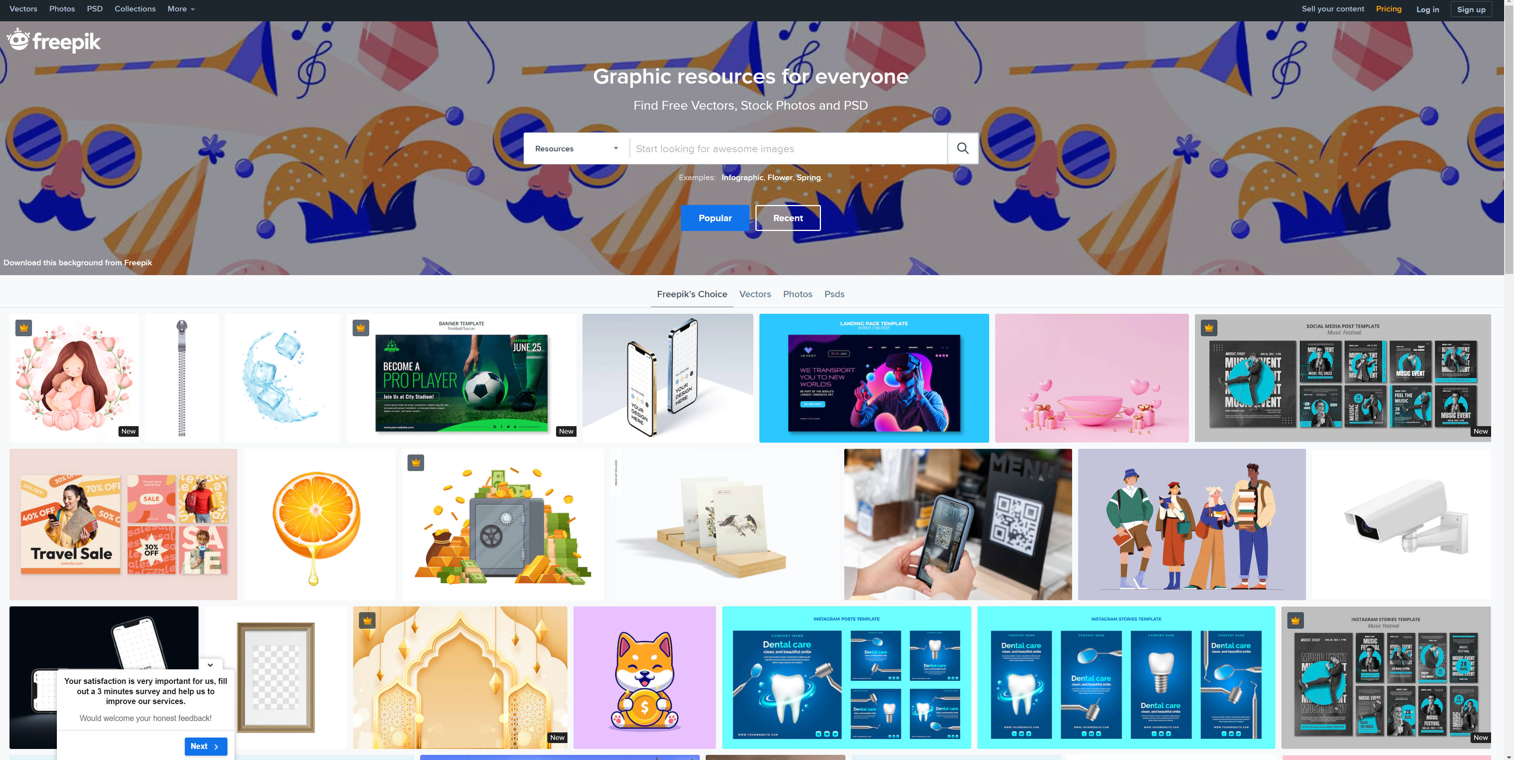
1.7 Free UI/UX Design Resources
https://www.freepik.com/
Freepik is a large material website, there are paid and free materials, Ability to search for the content you want to use, but only if you use the content to indicate the web source of the site

Slide 68
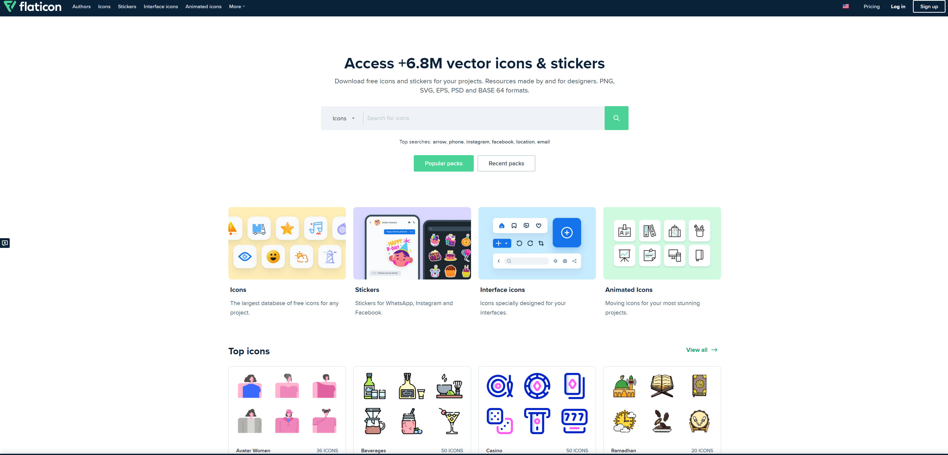
1.7 Free UI/UX Design Resources
https://www.flaticon.com/
Flaticon is the largest database of free customizable icons and stickers in the world. Flaticon has more than a million icons and stickers in all formats, for all kinds of projects: presentations, apps, websites, catalogs, infographics, etc.

Slide 69
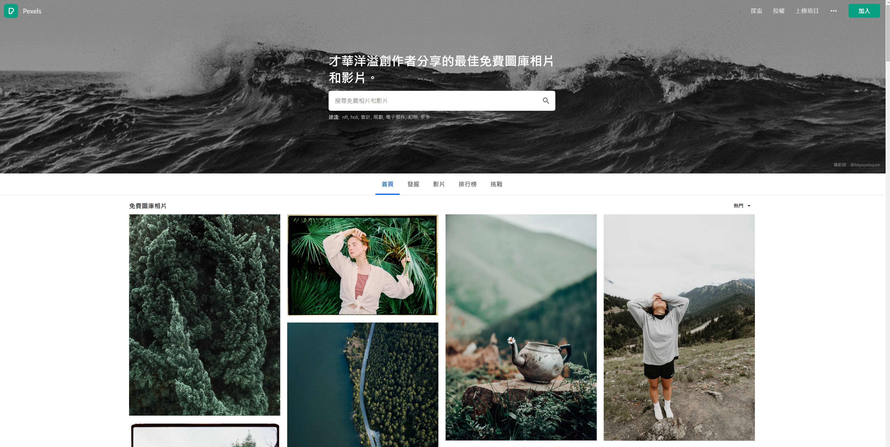
1.7 Free UI/UX Design Resources
https://www.pexels.com/zh-tw/
Pexels is a large site for free stock images, and you can use any image without citing the source of the image.

Slide 70

1.7 Free UI/UX Design Resources
https://dribbble.com/
Dribbble is a website for searching for ideas, you can’t download the resources on this website, but you can Browse content that interests you to inspire your own creativity and inspiration.

Slide 71

1.7 Free UI/UX Design Resources
https://dribbble.com/
For example, search a keyword ‘food’, you will see a lot different kinds of designs, from which you can find what you like, learn and for your reference.

Slide 72

1.7 Free UI/UX Design Resources
https://codepen.io/
CodePen is an online community for testing and showcasing user-created HTML, CSS, and JavaScript code snippets. It functions as an online code editor and open-source learning environment, where developers can create code snippets, called "pens," and test them.

Slide 73

1.7 Free UI/UX Design Resources
https://www.palettable.io/
Palettable is color scheme website, from designer collocation, from tens of thousands of color schemes, find the most suitable color combination for the design situation.

